Slide 1
ESTABLISHING REQUIREMENTS

Slide 2
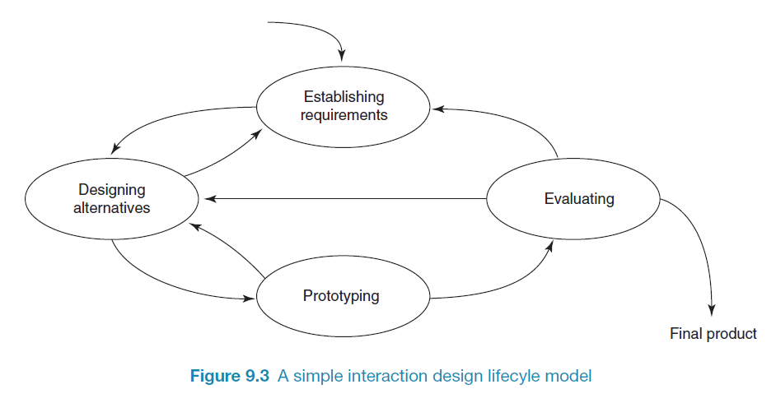
A simple interaction design lifecycle model
Exemplifies a user-centered design approach

Slide 3
What, how and why?
Why bother?
Requirements definition is the stage where failure occurs most commonly
Getting requirements right is crucial
3

Slide 4
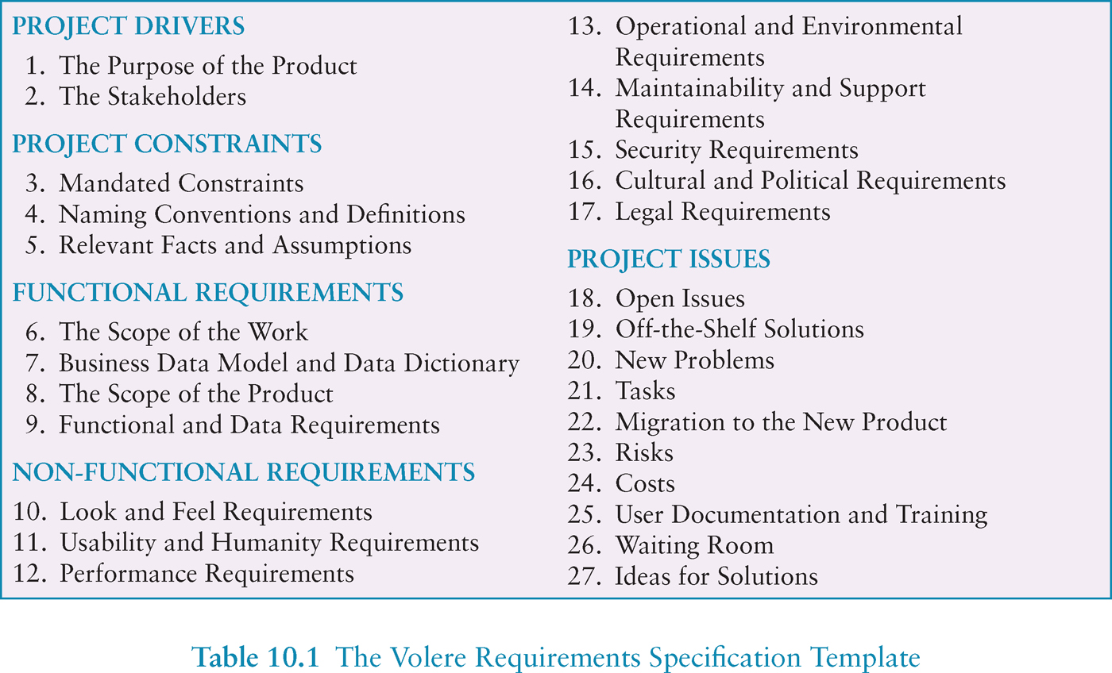
Volere requirements template

Slide 5
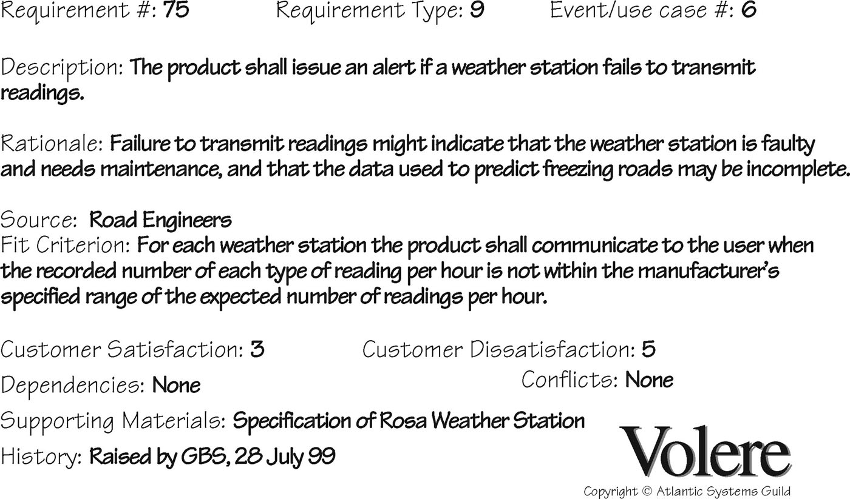
Volere shell

Slide 6
Different kinds of requirements

Slide 7
What are the users’ capabilities?
Humans vary in many dimensions:
size of hands may affect the size and positioning of input buttons
motor abilities may affect the suitability of certain input and output devices
height if designing a physical kiosk
strength - a child’s toy requires little strength to operate, but greater strength to change batteries
disabilities (e.g. sight, hearing, dexterity)

Slide 8
Example Persona

Slide 9
Task descriptions
Scenarios
an informal narrative story, simple, ‘natural’, personal, not generalisable
Use cases
assume interaction with a system
assume detailed understanding of the interaction
Essential use cases
abstract away from the details
does not have the same assumptions as use cases

Slide 10
Use case for travel organizer
1. The system displays options for investigating visa and vaccination requirements.
2. The user chooses the option to find out about visa requirements.
3. The system prompts user for the name of the destination country.
4. The user enters the country’s name.
5. The system checks that the country is valid.
6. The system prompts the user for her nationality.
7. The user enters her nationality.
8. The system checks the visa requirements of the entered country for a passport holder of her nationality.
9. The system displays the visa requirements.
10. The system displays the option to print out the visa requirements.
11. The user chooses to print the requirements.

Slide 11
Example essential use case for travel organizer
retrieve Visa
USER INTENTION SYSTEM RESPONSIBILITY
find visa requirements request destination and nationality supply required information obtain appropriate visa info obtain copy of visa info offer info in different formats choose suitable format provide info in chosen format

Slide 12
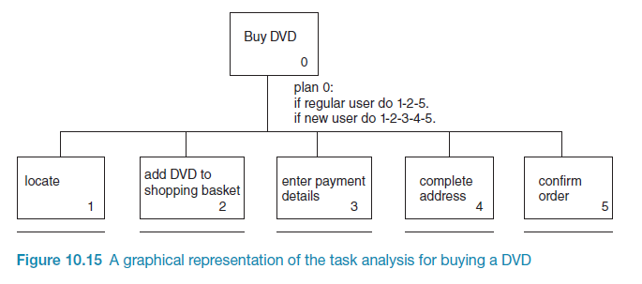
Example Hierarchical Task Analysis (graphical)

Slide 13
Summary
Getting requirements right is crucial
There are different kinds of requirement, each is significant for interaction design
The most commonly-used techniques for data gathering are: questionnaires, interviews, focus groups, direct observation, studying documentation and researching similar products
Scenarios, use cases and essential use cases can be used to articulate existing and envisioned work practices.
Task analysis techniques such as HTA help to investigate existing systems and practices

