Slide 1
Location of research

Slide 2
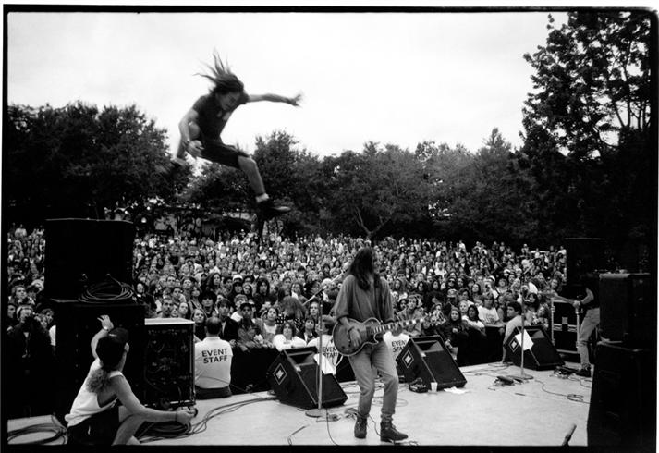


Does your location influence your behaviour?

Slide 3

Location of research
For the exam you have to…
be able to define and give an example of research that uses each location (laboratory, field and online)
be able to offer advantages and disadvantages of each location

Slide 4

Which type of research location is which?
Laboratory
Where data is collected from the participant via a website or app.
Online research
This is when research is conducted in an environment that is controlled by the researcher and is likely to be unfamiliar to the participant.
Laboratory research
An environment that is likely to be more familiar to the participant but less controlled by the researcher.
Field research
http://psych.hanover.edu/research/exponnet.html
https://www.socialpsychology.org/expts.htm
Field
Online

Slide 5
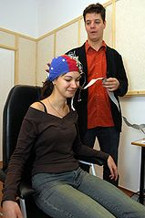
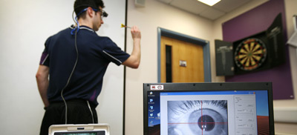
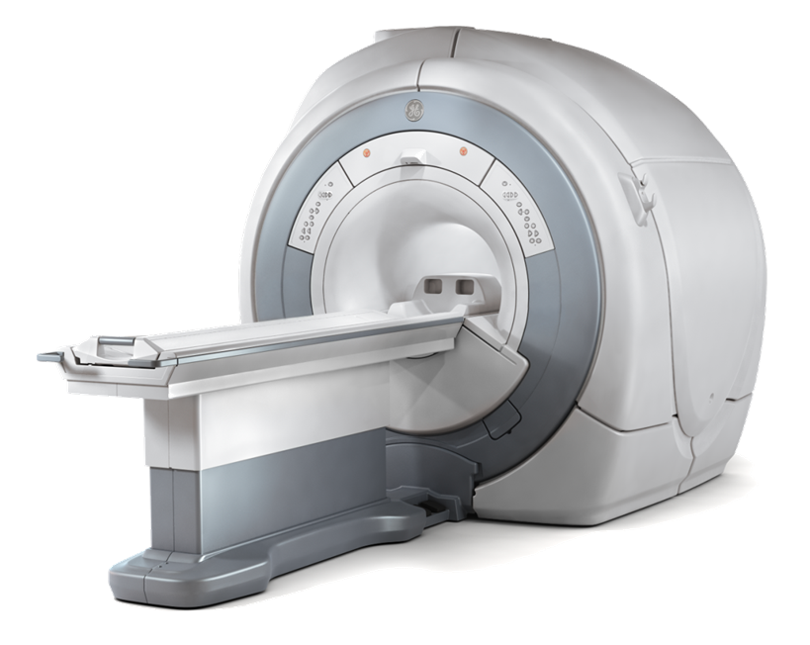
What do you think the advantages and disadvantages are of conducting research in a laboratory?

Slide 6
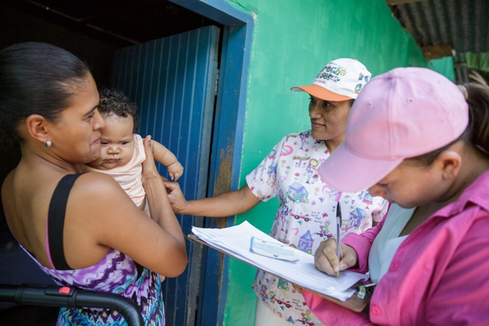
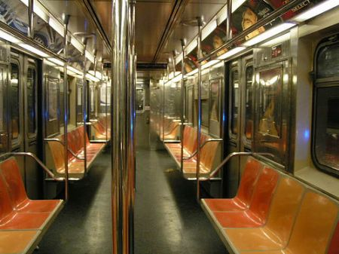

What do you think the advantages and disadvantages are of conducting research in the field?

Slide 7
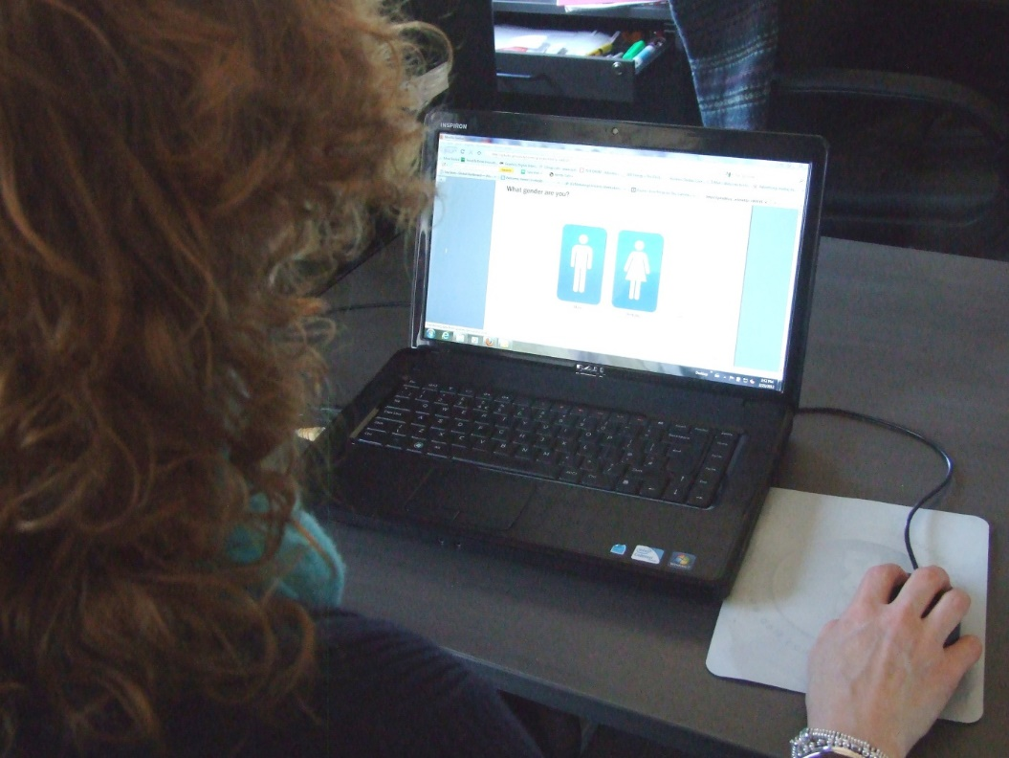


What do you think the advantages and disadvantages are of conducting research online?

Slide 8
Advantages of …?
Laboratory | Field | Online
1 Some research can’t be done in a laboratory, because of the nature of the behaviour e.g. anxiety when jumping out of an aircraft.
3 Allows the researcher to more easily control confounding or extraneous variables.
5 Allows the researcher to access a potentially large and culturally diverse population easily.
2 Can be quite cost effective as both delivery and analysis costs are less than traditional questionnaires.
4 By conducting research in a more natural environment, you may see more natural behaviour.
6 Allows the researcher to more easily use equipment, such as an MRI scanner.

Slide 9
Disadvantages of …?
Laboratory | Field | Online
1 It is more difficult for the research to control for confounding or extraneous variables.
3 Participants are in an artificial environment and so may behave artificially.
5 Unclear if participants are really giving fully informed consent; greater debriefing problems.
2 Research tends to be surveys, measuring attitudes rather than observing actual behaviour.
4 It makes it difficult for researchers to utilise large or delicate equipment.
6 Some research can’t be done in a laboratory, because of the nature of the behaviour e.g. anxiety when jumping out of an aircraft.

Slide 10
Which location would you recommend for the following research? Why?
Laboratory
Field
Online

Slide 11
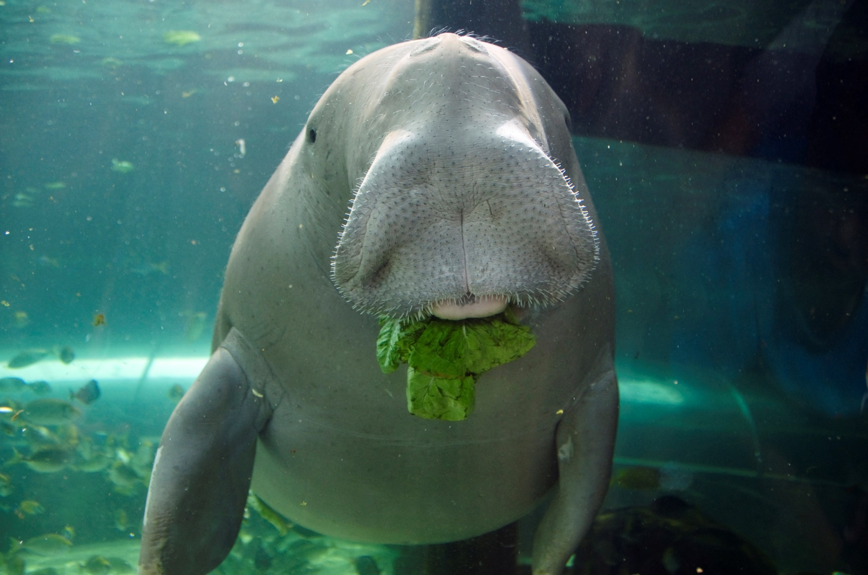
To investigate if dugongs eat alone or in groups.

Slide 12
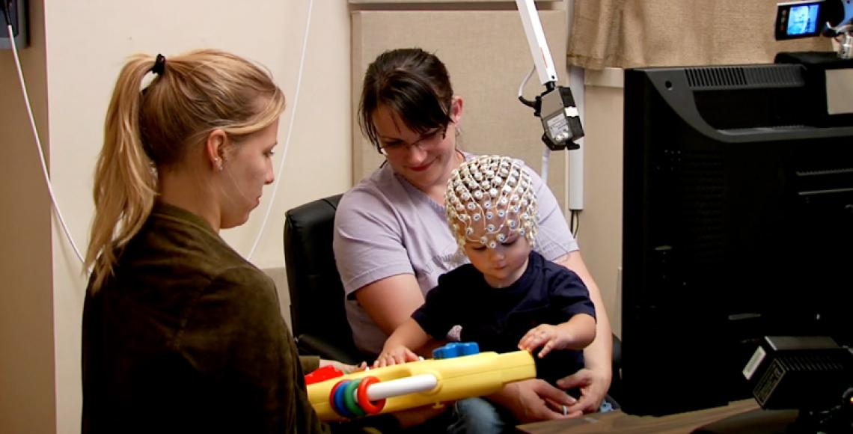
To investigate the brain activity of infants when playing with toys.

Slide 13
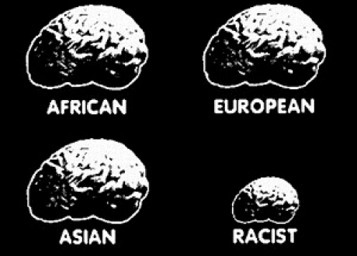
To investigate the prevalence of racism.

Slide 14
How could I use this information in an exam?
AO1 questions
What is meant by field research? [2]
Field research is when research is conducted in an environment that is likely to be familiar to the participant but less controlled by the researcher. For example, Pilliavin’s (1969) research on helping behaviour was conducted on the New York Subway.

Slide 15
How could I use this information in an exam?
AO2 questions
Scenario - To investigate the prevalence of racism.
2. Explain two advantages of the researcher conducting this research online. [2+2]
One advantage is that it allows the researcher to access a potentially large and culturally diverse population easily, therefore allowing a variety of people to offer their opinions about racism, rather than just people from one geographic location.
Another advantage is that it may be more time and cost effective to conduct an online survey about racism, than if traditional pen/paper methods were used.

Slide 16
How could I use this information in an exam?
AO3 questions
3. Explain why a psychologist would choose to conduct research in a laboratory rather than in the field. [4]
By using a laboratory, the psychologist would be able to use technical equipment more easily than if they were in the field e.g. it would be impossible to use an MRI scanner in a coffee shop. In addition, the psychologist would be able to control confounding variables more easily in a laboratory as the experience each participant has would be easier to replicate than if it were done in the field.

Slide 17

Which do you think is the best location to conduct research? Why?

